Slide 1
Project: Blackhole
A journey to understand a family’s history. Committed to remember those who did not make it and to constantly seeing the light.

Slide 2
How to define it:
Forced Migration: (also called deracination — originally a French word meaning uprooting) refers to the coerced movement of a person or persons away from their home or home region.
Genocide: the deliberate killing of a large group of people, especially those of a particular ethnic group or nation.
Internally Displaced People (IDP): is someone who is forced to flee his or her home but who remains within his or her country's borders. They are often referred to as refugees, although they do not fall within the current legal definition of a refugee. At the end of 2006 it was estimated there were 24.5 million IDPs in some 52 countries.

Slide 3
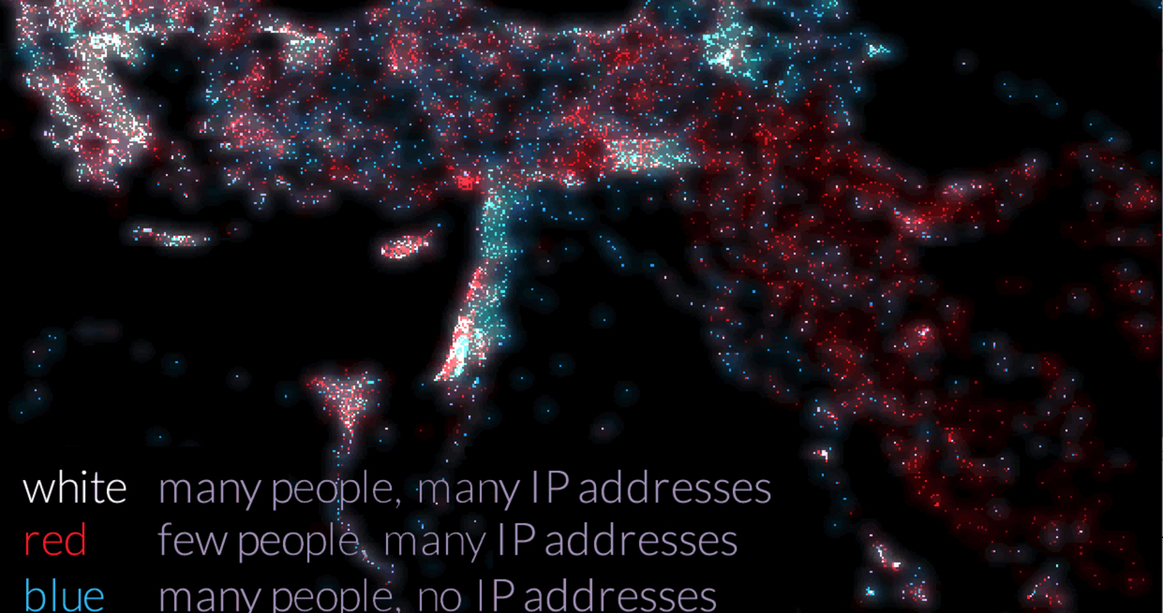
Inspiration

Slide 4
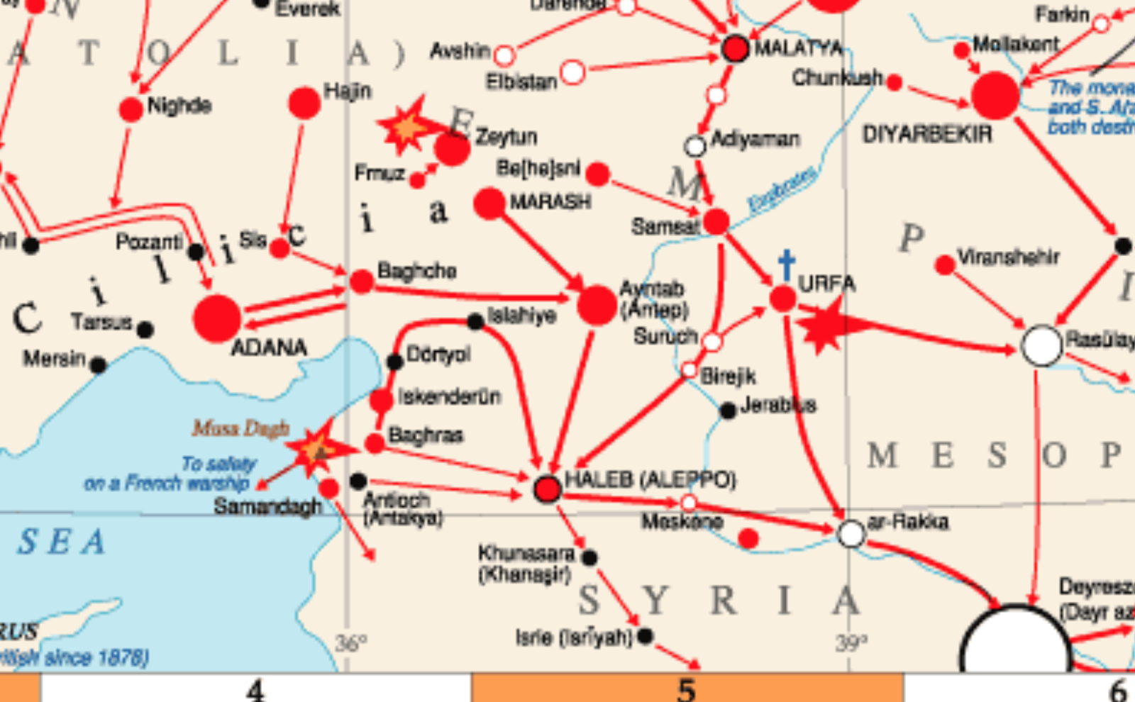
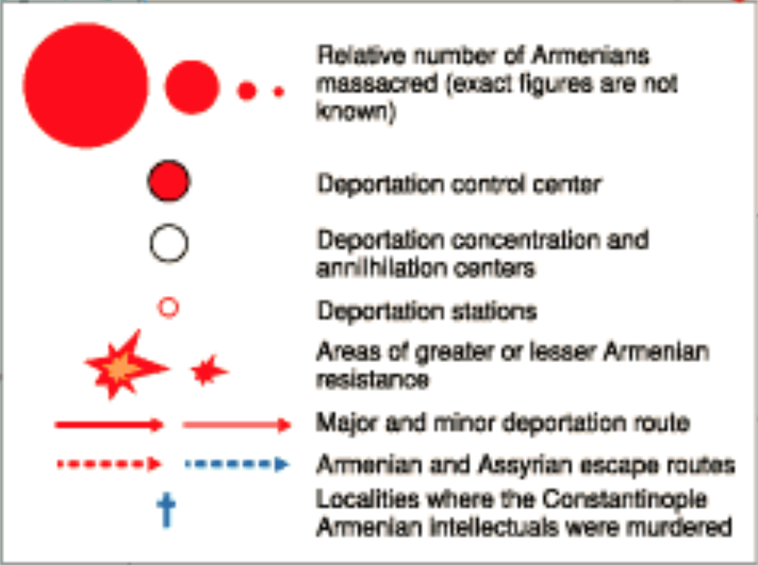

Slide 5
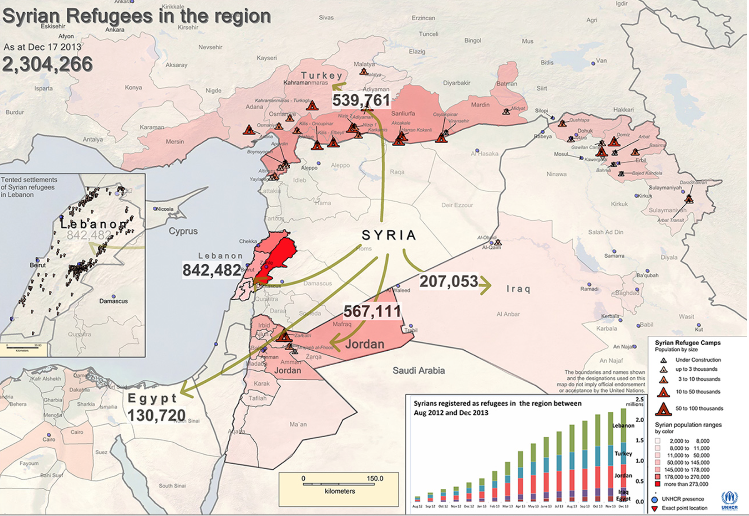

Slide 6
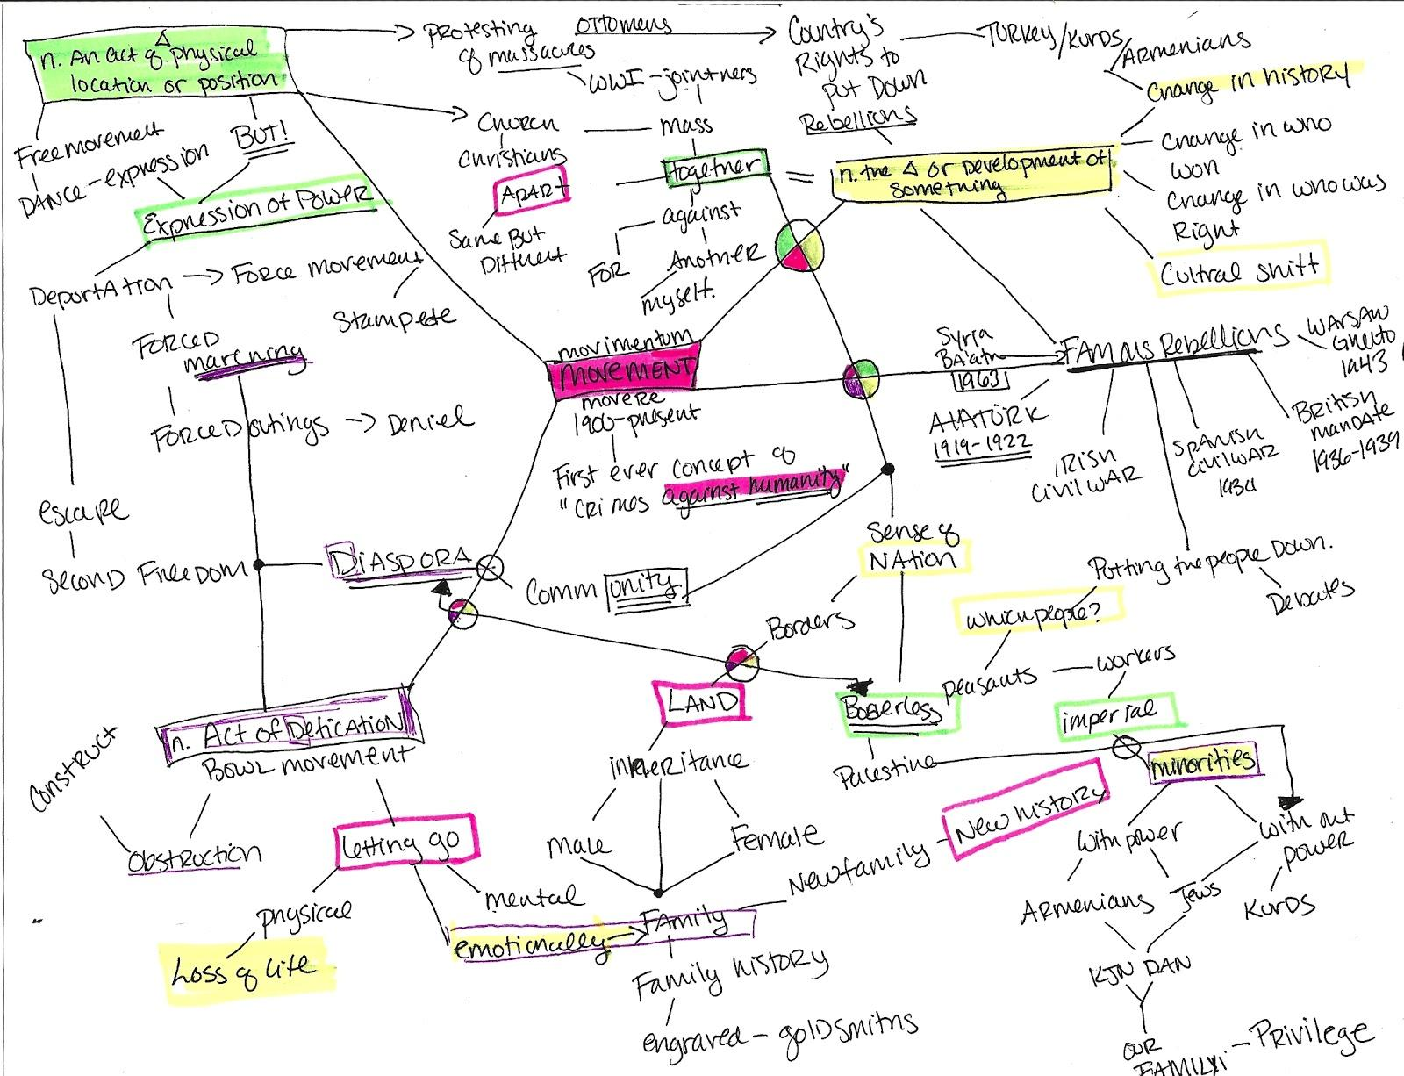
Mind Mapping

Slide 7
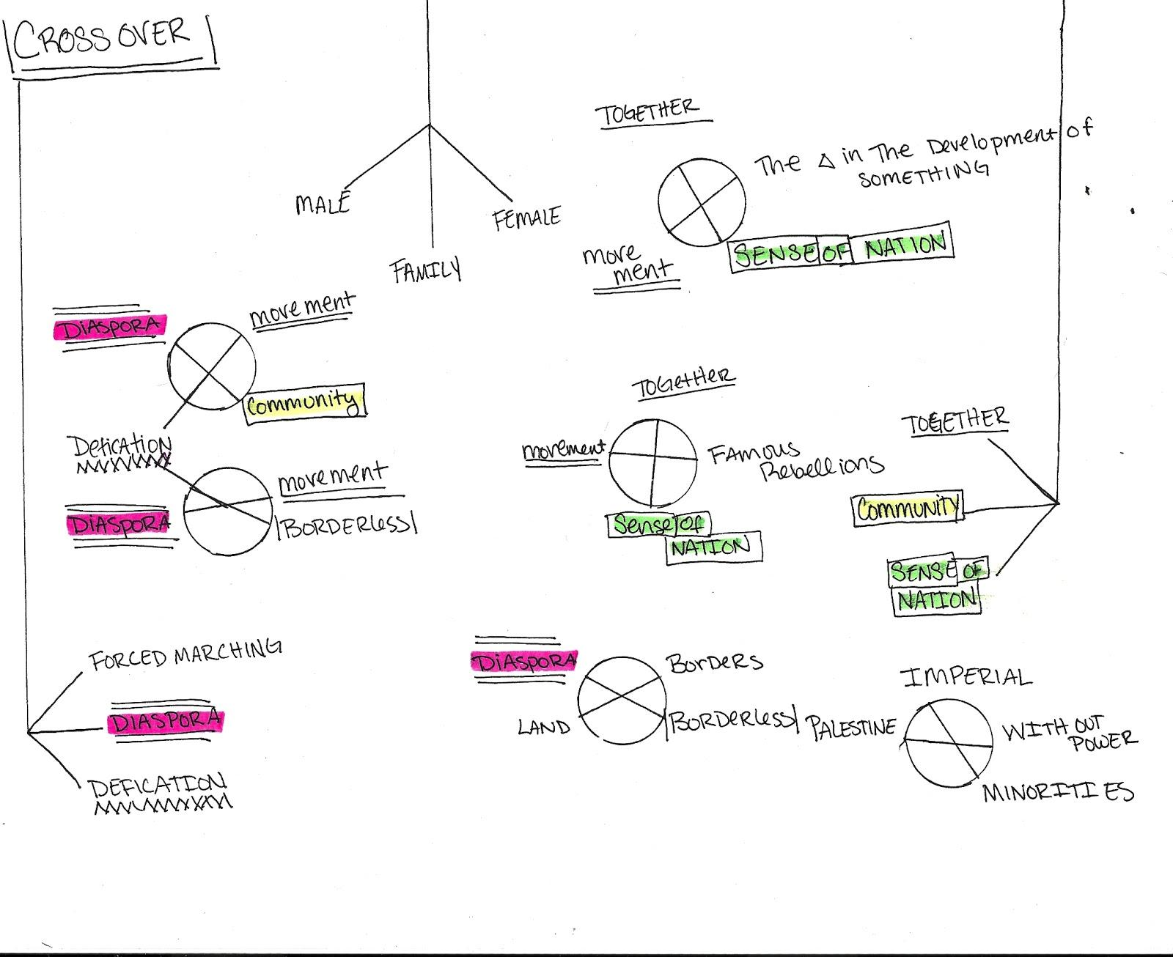
Context Analysis

Slide 8
Data as Individuals
Forced Migration
http://www.forcedmigration.org
UN Refugee Agency http://www.unhcr.org/cgi-bin/texis/vtx/home
Forced Migration Review - Syria
http://www.fmreview.org/syria
History
http://www.history.com/topics/armenian-genocide
International Organization for Migration
http://www.iom.int/cms/en/sites/iom/home.html

Slide 9
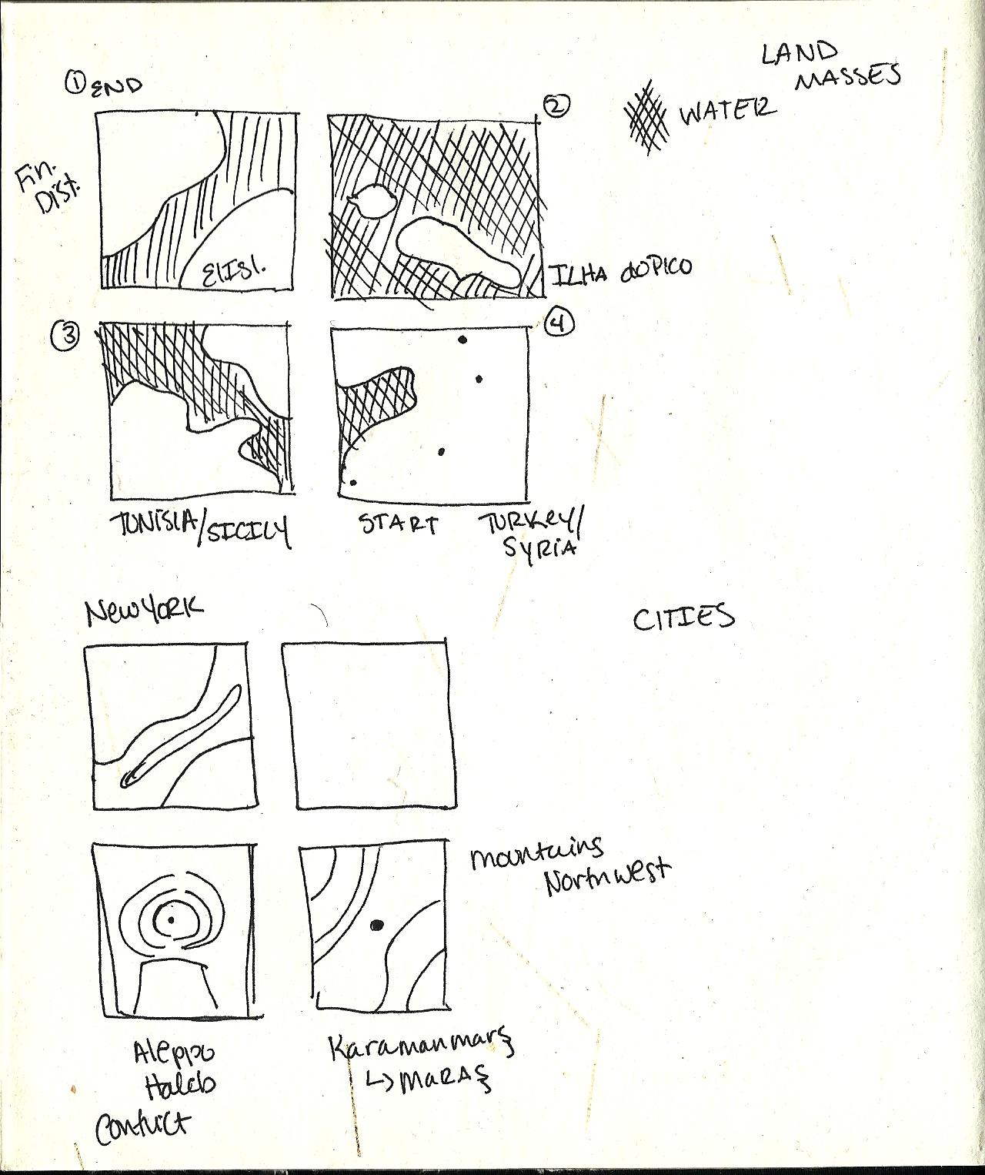
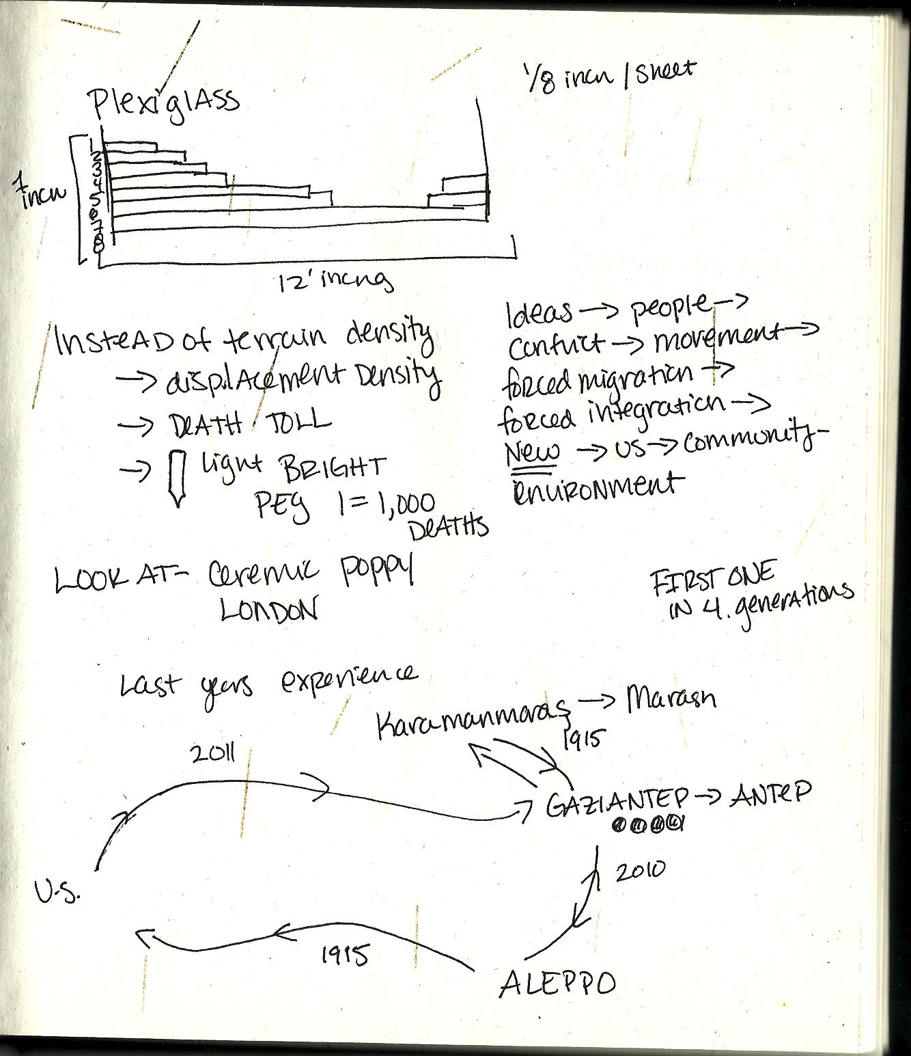
Flow Charts

Slide 10
Prototypes
3D!

Slide 11
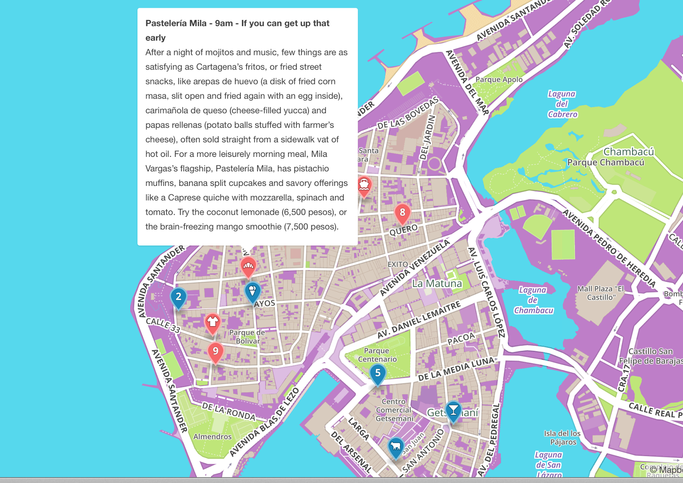
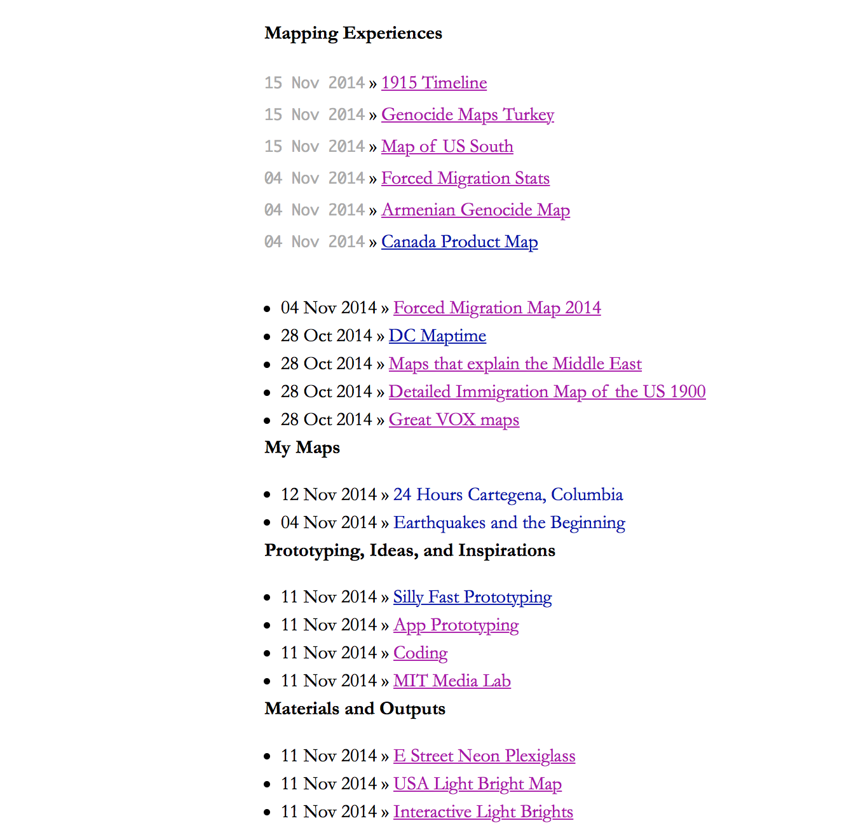
Blog postings

Slide 12
Next Steps
Finalize the numbers
Determine the material/purchase
Choose and map out cities
Mock up landscape for topography maps
Build some sh*t
Figure out lighting

